Slide 1


Influential Misinformation Social Media Post Tracer
CDT Gikonyo Njendu

Slide 2
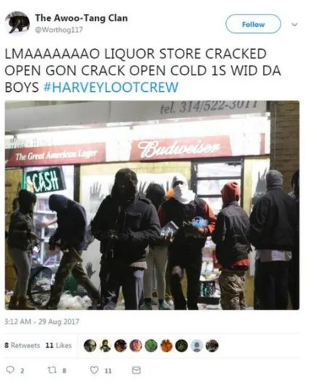
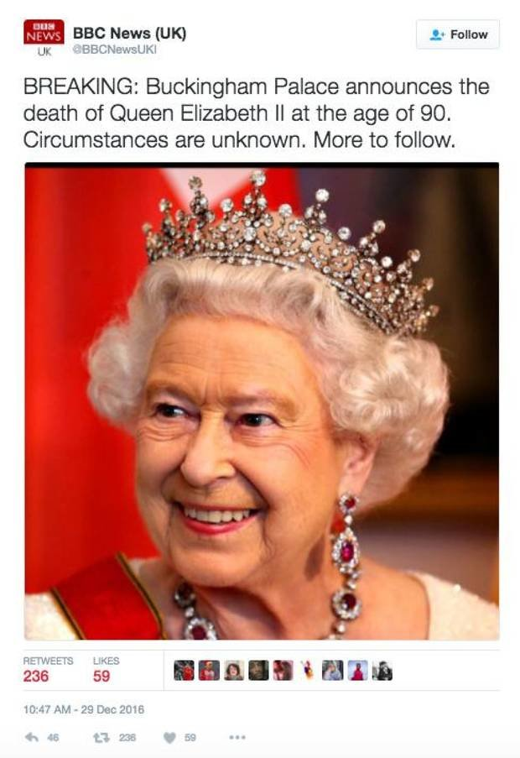
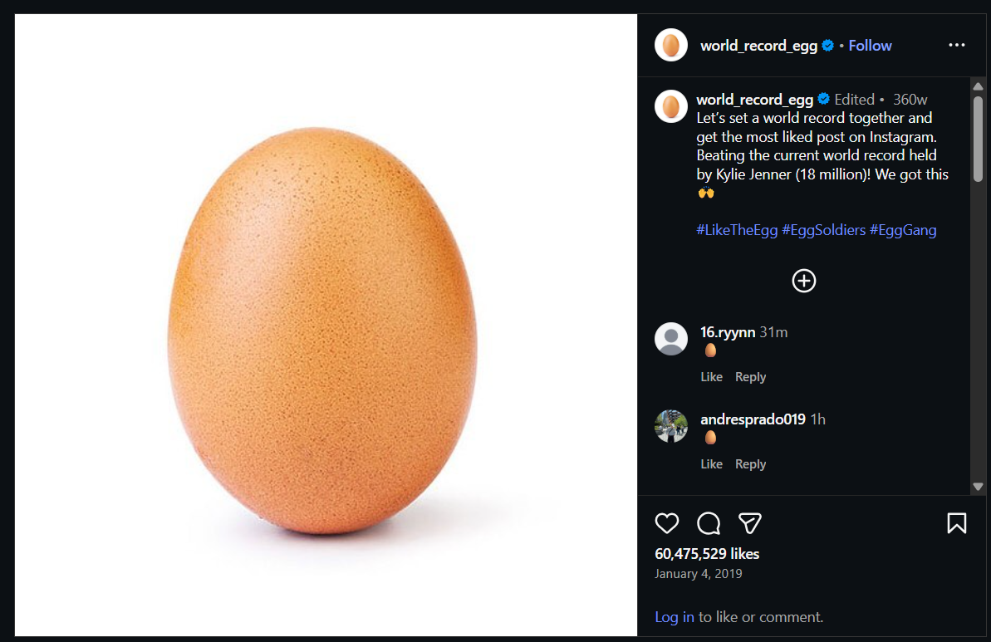
Introduction

Slide 3
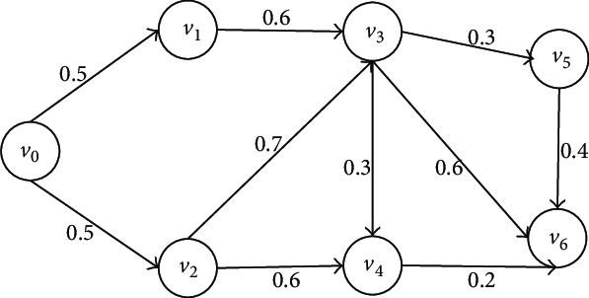
Method (Definition)
Nodes: Social Media Posts
Similarity: Score from 0 to 1 on how similar
BERT model by google (HuggingFace Model)
Semantic similarity, not lexical
Edges: Influence on neighboring social media post
Connection: Similarity > 0.5
Weight: (Similarity)/(1-0.5) – 1
Direction: Older posts point to newer posts
  If same date, no connection
Dataset (Kaggle): Textual dataset with 12,600 articles from reuter.com and 12,600 articles from different fake news outlet resources. The labels in the dataset are the title, text, subject, and date.

Slide 4
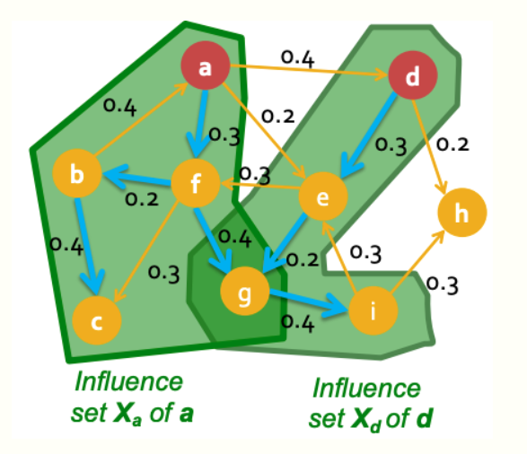
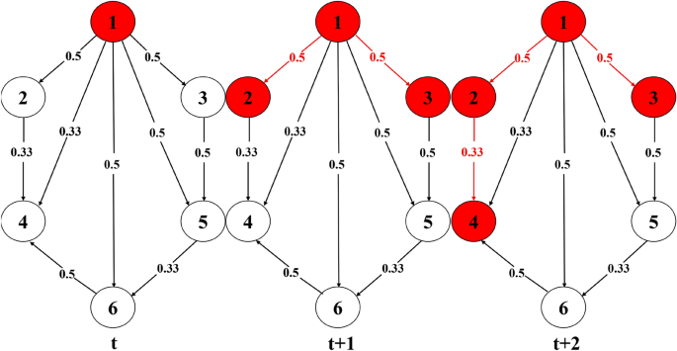
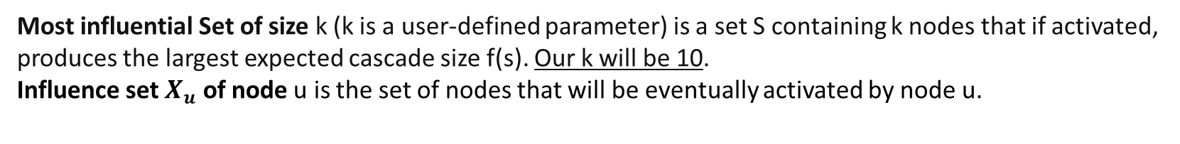
Method (Procedure)
Independent Cascade Model
Most influential Set of size k (k is a user-defined parameter) is a set S containing k nodes that if activated, produces the largest expected cascade size f(s). Our k will be 10.
Influence set $X_{u}$ of node u is the set of nodes that will be eventually activated by node u.

Slide 5
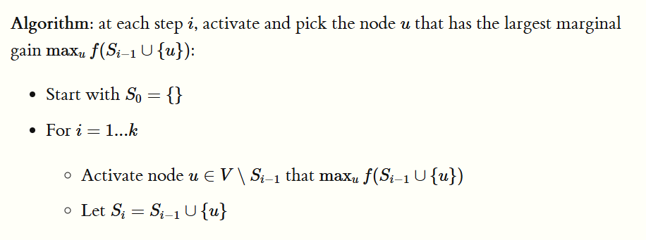

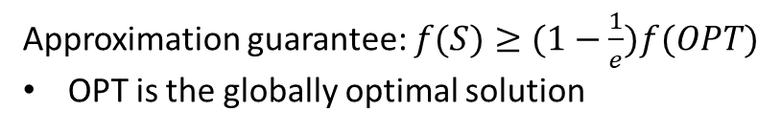
Method (Procedure Cont.)
Greedy approximation algorithm- Hill Climbing
NP-hard!!
NP-hard!!
NP-hard!!
Optimization problem:$\max_{\text{S} \text{of} \text{size} \text{k}}{f(s)}$
NP-hard!!
NP-hard!!
NP-hard!!
Augmentation on algorithm: Node may only be activated if it is misinformation.
Approximation guarantee: $f(S)≥(1−\frac{1}{e})f(OPT)$
OPT is the globally optimal solution

Slide 6
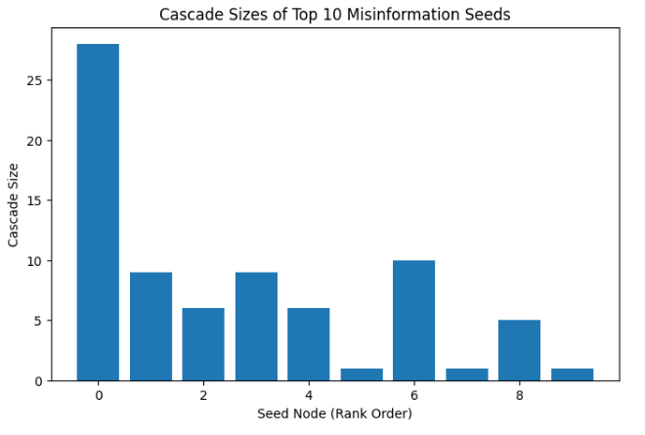
Results
=====================================
MOST INFLUENTIAL MISINFORMATION POST
=====================================
Node ID: 429
Date: 2016-12-07 00:00:00
Label: fake
----- TEXT CONTENT -----
Democrats Introduce Legislation To Probe Russian Voting Hacks, ..... [423]
------------------------
Influence Cascade Size: 34 nodes
Nodes influenced by this post:
[384, 69, 582, 1479, 391, 726, 268, 399, 15, 275, 1108, 917, 1109, 151, 1048, 153, 154, 793, 27, 733, 1310, 479, 1119, 411, 98, 1247, 678, 1127, 429, 369, 626, 755, 184, 1214]

Slide 7
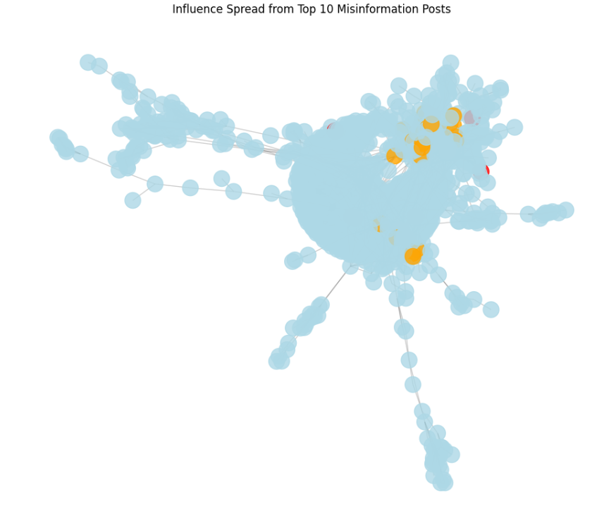
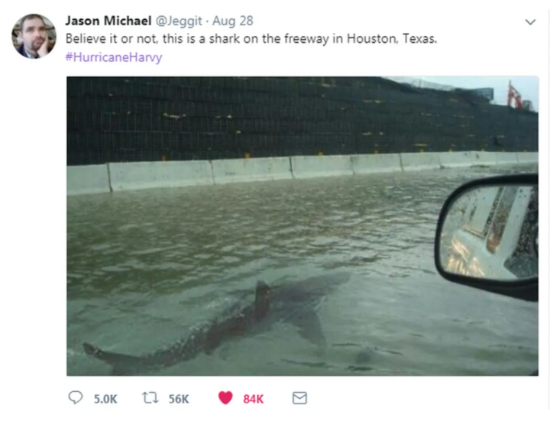
Conclusions & Future Work
Future Work
  Use this strategy with image + text social media posts
  Explore adversarial attacks on the network, an adversarial actor flooding the network with misinformation
  Convolutions on graph to improve influence representation

Slide 8
Questions?

Slide 9
Citations
https://snap-stanford.github.io/cs224w-notes/network-methods/influence-maximization
https://medium.com/msackiit/what-is-text-similarity-and-how-to-implement-it-c74c8b641883
https://www.kaggle.com/datasets/islamic/fake-news-classification
https://www.kaggle.com/refs/hf-model/google-bert/bert-base-uncased
https://huggingface.co/sentence-transformers/all-MiniLM-L6-v2

